Slide 1



STUDYING NETWORK ATTACKS AND UNDERSTANDING DOS AND DDOS ATTACKS
Ishan Arif Mardani, 21CS01023

Slide 2

What is a Network Attack?
Network attacks are malicious activities aimed at exploiting vulnerabilities in computer networks to gain unauthorized access, steal data, disrupt services, or cause other forms of harm. These attacks can target various layers of the network stack.

Slide 3

TYPES OF NETWORK ATTACKS

Slide 4
Data Link Layer
MAC Address Spoofing: Manipulating the Media Access Control (MAC) addresses to impersonate another device on the network.
ARP Spoofing/ARP Poisoning: Manipulating the Address Resolution Protocol (ARP) cache to associate the attacker's MAC address with the IP address of another legitimate device on the network.

Slide 5
Network Layer
IP Spoofing: Falsifying the source IP address in IP packets to impersonate another device or to bypass access controls.
ICMP Flood: Flooding a target with a high volume of Internet Control Message Protocol (ICMP) packets, often used in DDoS attacks.
Routing Attacks: Manipulating routing tables to redirect traffic to unauthorized destinations.
.

Slide 6
Transport Layer
SYN Flood: Exploiting the TCP three-way handshake process by sending a high volume of SYN requests without completing the handshake, causing the target to allocate resources and eventually become unavailable.
UDP Flood: Flooding a target with User Datagram Protocol (UDP) packets, often used in DDoS attacks.
.

Slide 7
Application Layer
SQL Injection: Injecting malicious SQL queries into input fields of web applications to manipulate databases.
Cross-Site Scripting (XSS): Injecting malicious scripts into web pages viewed by other users.
Phishing: Deceptive techniques to trick users into revealing sensitive information through emails, websites, or other forms of communication.
Malware: Attacks such as viruses, worms, Trojans, and ransomware targeting vulnerable applications or users at the application layer.
.

Slide 8
DOS AND DDOS ATTACKS

Slide 9
What is a DoS Attack?
A Denial-of-Service (DoS) attack is a malicious attempt to disrupt the normal functioning of a targeted server, service, or network by overwhelming it with a flood of illegitimate traffic or resource requests. The goal of a DoS attack is to render the target inaccessible to its intended users, causing disruption or denial of service.

Slide 10
TYPES OF DOS ATTACKS

Slide 11
Volumetric Attacks (Gbps)
Volumetric attacks can also be called “floods” because this attack floods a target’s server with requests, like unwanted pings. Attacks are measured in bits per second (bps) or Gigabits per second (Gbps). Volumetric DDoS attacks flood servers with traffic to overload bandwidth, often using DNS amplification or IoT botnets. Exploiting insecure IoT devices, attackers easily launch devastating attacks with minimal resources.

Slide 12
Protocol Based Attacks (PPS)
Protocol attacks often work at the network layer, and hence they are measured in packets per second (pps). Examples -
A Ping of death is an attack, in which the attacker aims to disrupt a targeted machine by sending a packet larger than the maximum allowable size, Some TCP/IP systems were never designed to handle packets larger than the maximum, making them vulnerable to packets above that size.
A TCP SYN flood is another common protocol attack. Here, a surge of TCP SYN requests directed towards a target overwhelms the target and makes it unresponsive.

Slide 13
Application Layer Attacks (RPS)
Application Layer DDoS attacks mimic legitimate user requests, making them harder to detect. These attacks, measured in requests per second (RPS), focus on overwhelming CPU and memory resources. They involve hitting web servers, running scripts, and accessing databases, slowing down systems.
Examples are SQL injection and XSS.
Cross-site scripting (XSS) is an attack in which an attacker injects malicious executable scripts into the code of a trusted application or website. Attackers often initiate an XSS attack by sending a malicious link to a user and enticing the user to click it.

Slide 14
TCP SYN FLOOD

Slide 15
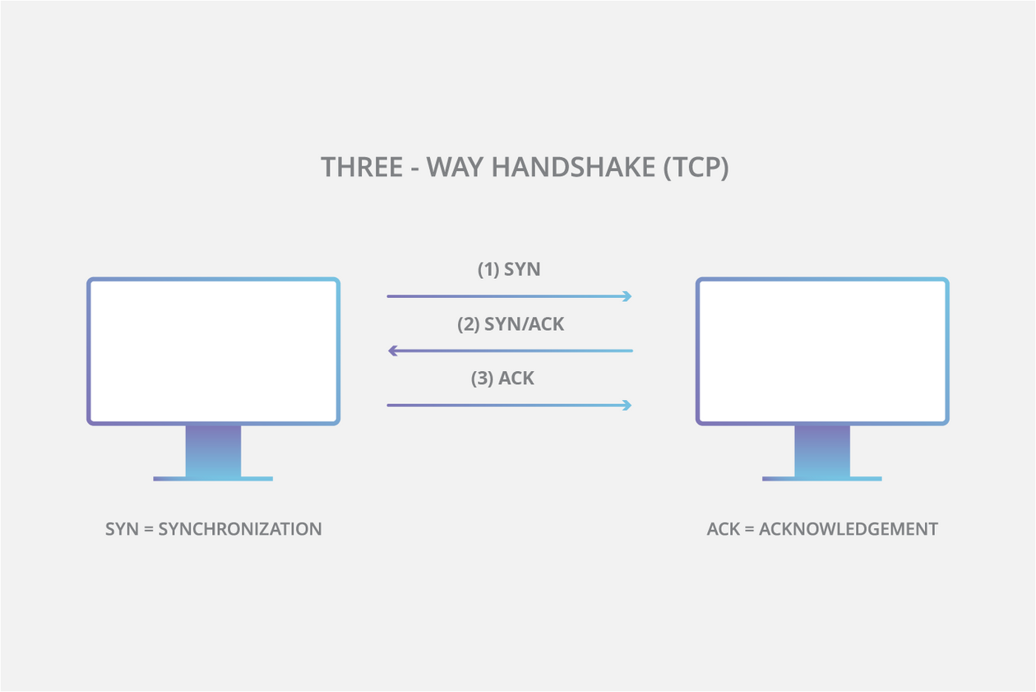
TCP connection exhibits three distinct processes in order to make a connection.
First, the client sends a SYN packet to the server to initiate the connection.
The server then responds to that initial packet with a SYN/ACK packet, to acknowledge the communication.
Finally, the client returns an ACK packet to acknowledge the receipt of the packet from the server. After completing this sequence of packet sending and receiving, the TCP connection is open and able to send and receive data.

Slide 16
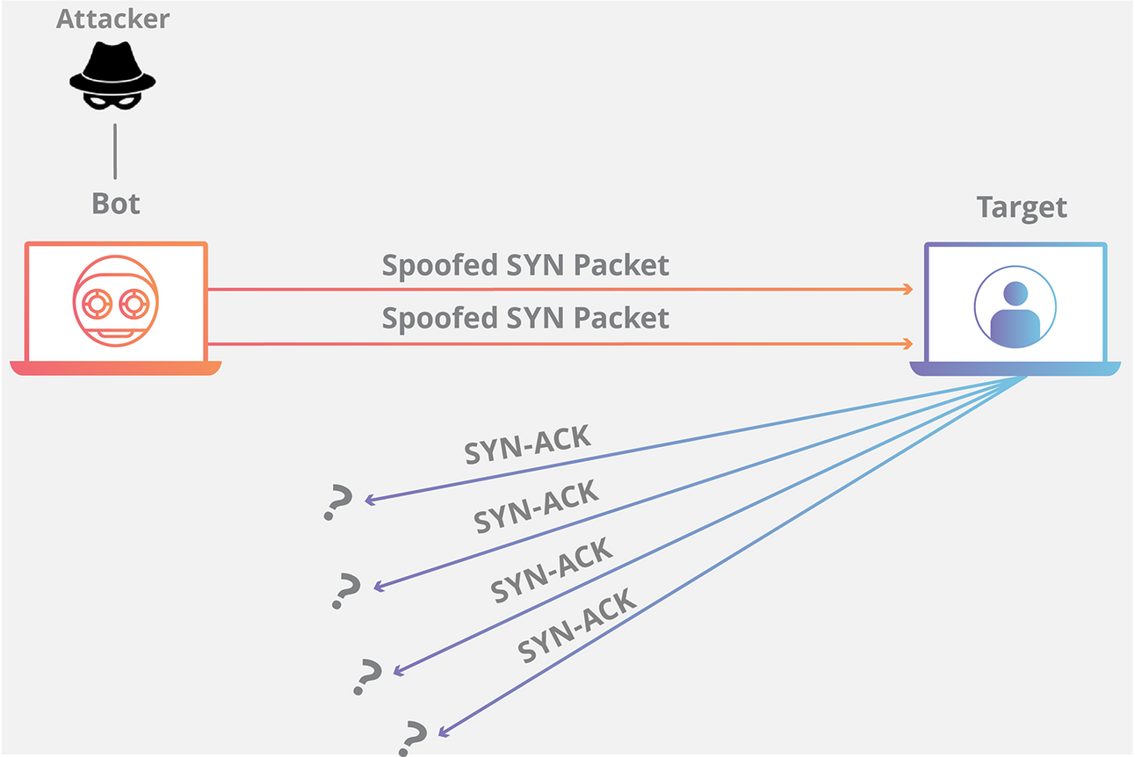
Here’s how DOS attack works -
In a SYN flood DoS attack, the attacker floods the server with SYN packets, each initiating a connection. The server responds and holds open a port, awaiting confirmation which never arrives. However, as the attacker floods with more SYN packets, the server's resources are exhausted, unable to process legitimate requests. This overwhelms the server, rendering it unable to handle genuine traffic, leading to service disruption or downtime.

Slide 17
DEMONSTRATION OF TCP-SYN FLOOD

Slide 18
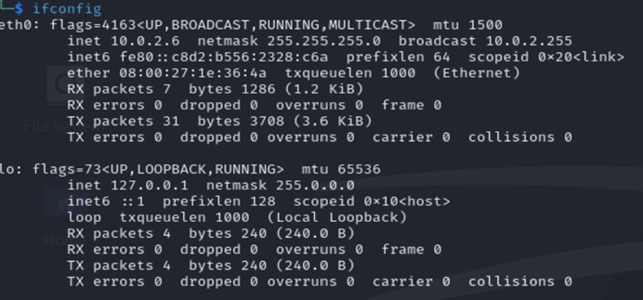

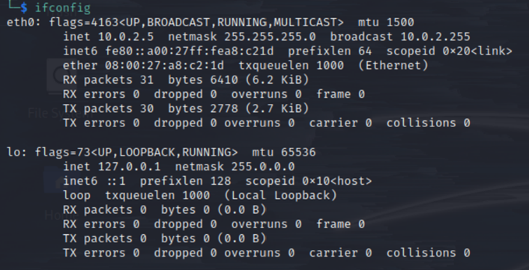
Target
Attacker
We are using 2 separate instances of Linux running on VirtualBox as the target and the attacking machine.

Slide 19
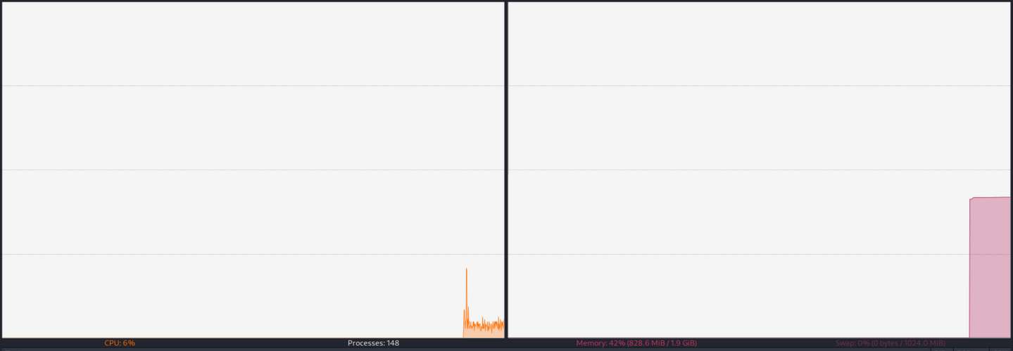
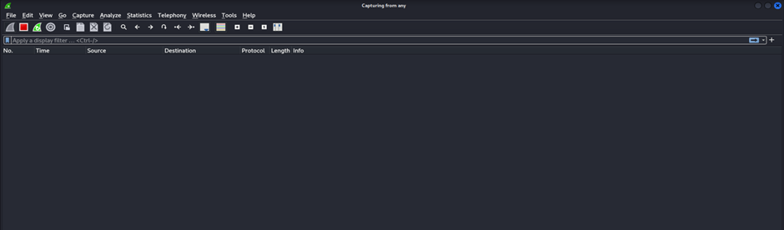
Task Manager
Wireshark
Now we have opened the Task Manager and the Wireshark packet analyzer in the target machine for monitoring purposes.

Slide 20
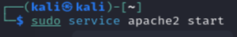
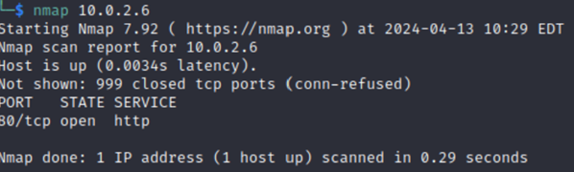
Now we will open a apache2 server from the target side
On doing an nmap scan on the source VM of the target IP we find that there is an open port 80 in the target due to the apache server running.

Slide 21
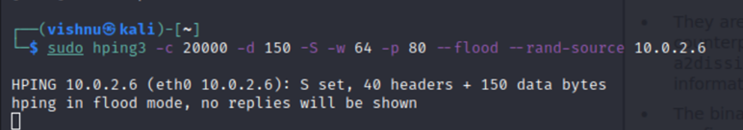
For this demonstration we will be using hping3, a popular TCP penetration testing tool. This is the command used by the source to perform DoS attack on the target
We’re sending 20000 packets (-c 20000) of size of 150 bytes (-d 150) each. We’re specifying that the SYN Flag (-S) should be enabled, with a TCP window size of 64 (-w 64). To direct the attack to our target’s HTTP web server we specify port 80 (-p 80) and use the --flood flag to send packets as fast as possible. The --rand-source flag generates spoofed IP addresses to disguise the real source and avoid detection but at the same time stop the victim’s SYN-ACK reply packets from reaching the attacker.

Slide 22
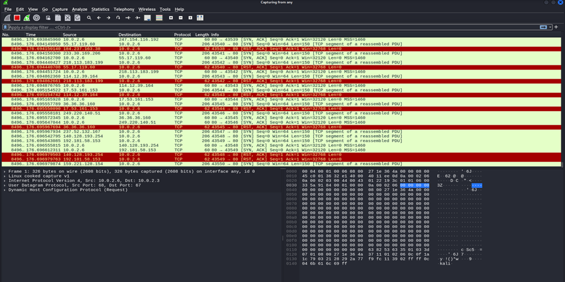
This is a snapshot of Wireshark at a particular instance of time, on the target VM. We can see multiple SYN packets being received

Slide 23
As we can see, there’s a high volume of SYN packets with very little variance in time. Each SYN packet shows it’s from a different source IP address with a destination port 80 (HTTP), identical length of 150 and window size (64).

Slide 24
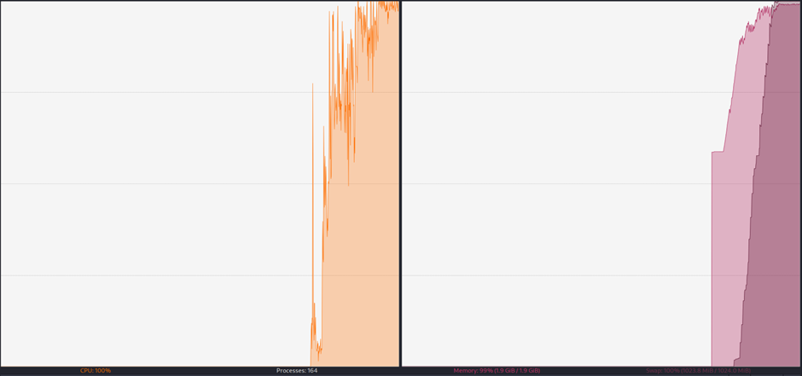
We also observe a spike in CPU and memory usage. After some time the target VM crashed due to heavy load on its CPU. Thus we have successfully demonstrated the Denial of Service attack of SYN flooding.

Slide 25
PREVENTION METHODS

Slide 26
TCP Intercept
TCP intercept in routers prevents TCP SYN floods by intercepting and confirming the connection request before it reaches the target.
In intercept mode, the router intercepts TCP synchronization requests and establishes a connection on behalf of the server. If the connection is completed, it means the client has established a connection to the server, and the two connections are merged. The router provides a timeout for half-open connections to prevent its own resources from being depleted. In monitoring mode, the router passively observes the connection request through the router. If the connection exceeds the configured set-up time, the router will close the connection.

Slide 27
Attack Surface Reduction
The attack surface refers to the potential vulnerabilities and entry points that attackers can exploit to gain access to an organization’s computer systems and networks. Limiting attack surface exposure can help minimize the effect of a DDoS attack. Several methods for reducing this exposure include restricting traffic to specific locations, implementing a load balancer, and blocking communication from outdated or unused ports, protocols, and applications.

Slide 28
Real-time, Adaptive Threat Monitoring
Threat monitoring or Intrusion Detection Systems can help pinpoint potential threats by analyzing network traffic patterns, monitoring traffic spikes or other unusual activity. It also adapts to defend against anomalous or malicious requests, protocols, and IP blocks. An example is Snort which is an open source network Intrusion Detection System.

Slide 29
Rate Limiting
Rate limiting restricts the volume of network traffic over a specific time period, essentially preventing web servers from getting overwhelmed by requests from specific IP addresses. Rate limiting can be used to prevent DDoS attacks that use botnets to spam an endpoint with an abnormal amount of requests at once.

Slide 30
REFERENCES
HPING Source Code
https://github.com/antirez/hping
Research Papers
https://www.researchgate.net/publication/259941506_DoS_and_DDoS_Attacks_Impact_Analysis_and_Countermeasures
https://www.ijert.org/research/denial-of-service-attacks-tools-and-categories-IJERTV9IS030289.pdf

Slide 31
﻿THANK YOU

